Slide 1

Real Estate Price Predictor
A project for buymydreamhome.com

Slide 2



Case Study
buymydreamhome.com is our client. They sell properties along all US.
buymydreamhome.com has several hundreds thousands of properties listed in its databases.
For the future they want to create a tool that helps agents and clients to set a price.
Proposal
The idea is that a tool suggest a price for the future possible property.
In one hand clients would have an orientation about the value of their real state.
In the other hand agents can check and give advice to customers to put a reasonable price to the properties listed.

Slide 3

Our Data
More data insights are available in the Dashboard:
https://public.tableau.com/app/profile/luis.blanco7792/viz/mid_project_ironhack/SalesPriceAnalysis

Slide 4
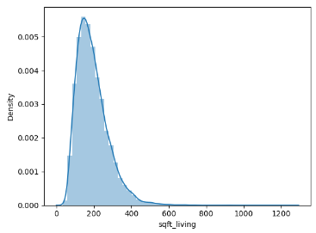
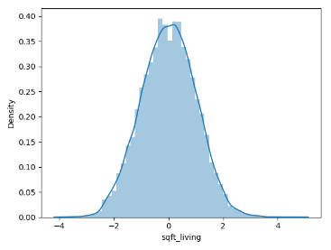
Challenges
We have dropped zip code , date, year renovated,year built and ID as they were not highly correlated with our target column.
New feature has been added ‘House Age’
Transformations :Yeo-Johnson
BEFORE
AFTER

Slide 5
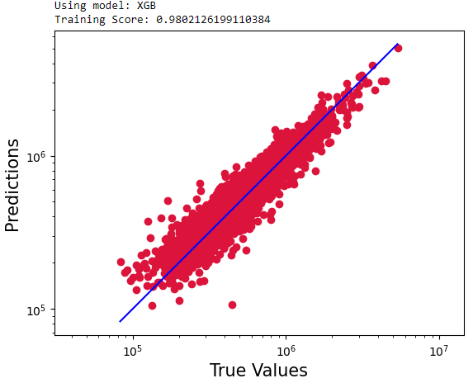
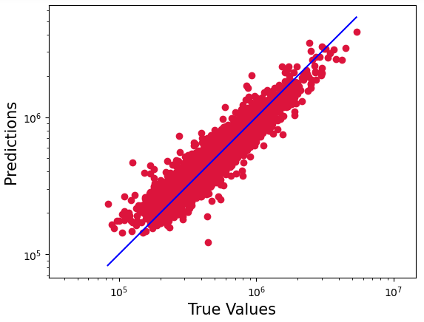
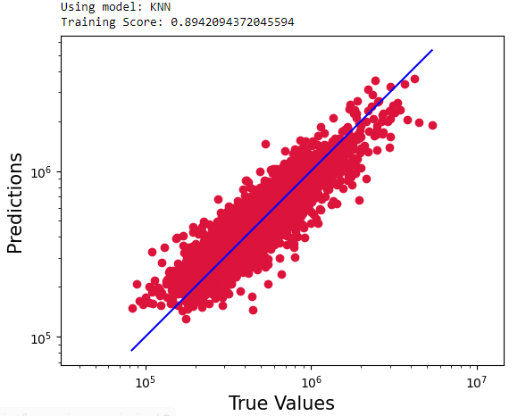
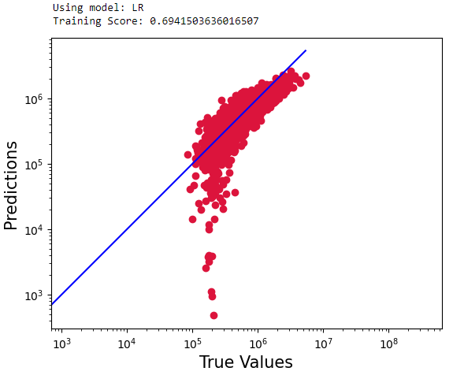
Model selection
XGBoost
R2 Score = 0.91
Random forest
R2 Score = 0.89
KNN
R2 Score = 0.78
Linear regression
R2 Score = 0.70
Reference : https://github.com/lj90pot/Mid_project_chilli_flakes/tree/main/Python_Notebook

Slide 6
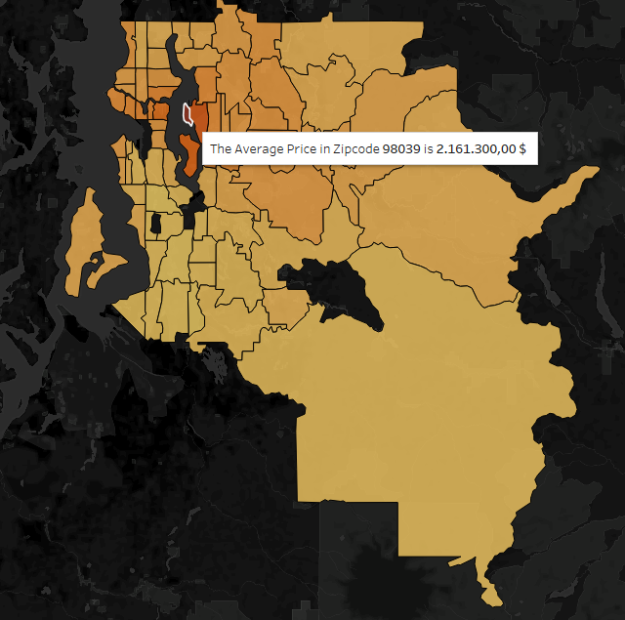

Conclusions
Factors affecting selling price
Ability to compare two areas on map for price.
Future enhancement to the model:
Feature addition (location,garage,school locality, public transport connectivity)
Multiple Sales
Different algorithms like SVM

Slide 7
Thank you!

